Slide 1
SPEECH AND TEXT RECOGNITION
Under the guidance of
Mrs. J. JAYANTHI

Slide 2
TEAM MEMBERS:
P. KARTHIK
U. NAGASAI
P. CHIRANJEEVI
G. ABHIRAM

Slide 3
CONTENTS
OBJECTIVE
INTRODUCTION
WORKING PRINCIPLE
IMPLEMENTATION
INPUT AND OUTPUT
DEMO VIDEO
CONCLUTION

Slide 4
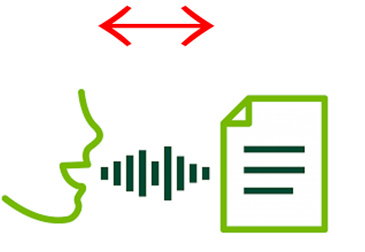
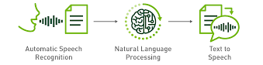
OBJECTIVE
To recognition and translation of spoken language into text and text to spoken language and through computational linguistics..

Slide 5
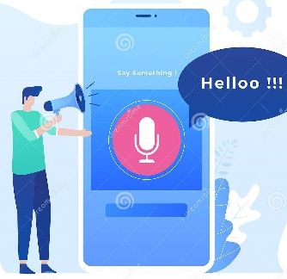

INTRODUCTION
Speech-to-text (STT) is a
speech recognition software that enables the recognition and translation of spoken language into text through computational linguistics. It is also known as speech recognition or computer speech recognition.
Text-to-speech (TTS) is a type of assistive technology that reads digital text aloud. It’s sometimes called “read aloud” technology.
With a click of a button or the touch of a finger, TTS can take words on a computer or other digital device and convert them into audio
A voice assistant is a digital assistant that uses voice recognition, language processing algorithms, and voice synthesis to listen to specific voice commands and return relevant information or perform specific functions as requested by the user.

Slide 6
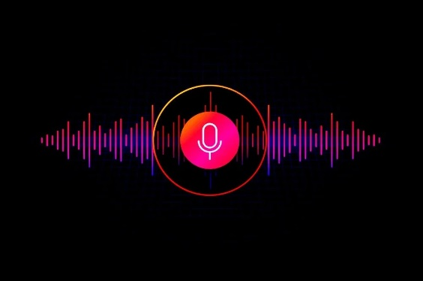
Working principle
Speech recognition:
software works by breaking down the audio of a speech recording into individual sounds, analyzing each sound, using algorithms to find the most probable word fit in that language, and transcribing those sounds into text.
TTS :
ML system perform the following
Convert text to words
Complete phonetic transcription
Convert transcription to speech

Slide 7
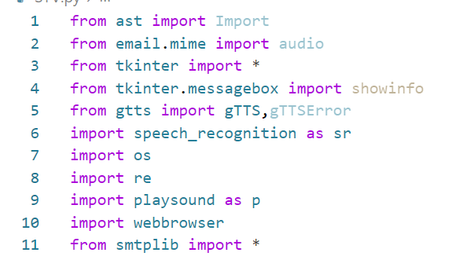

IMPLEMENTATION

Slide 8

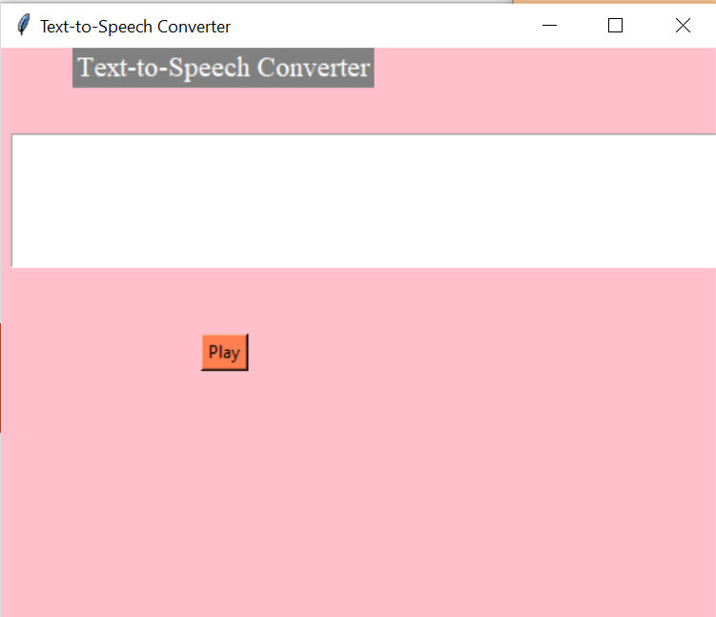
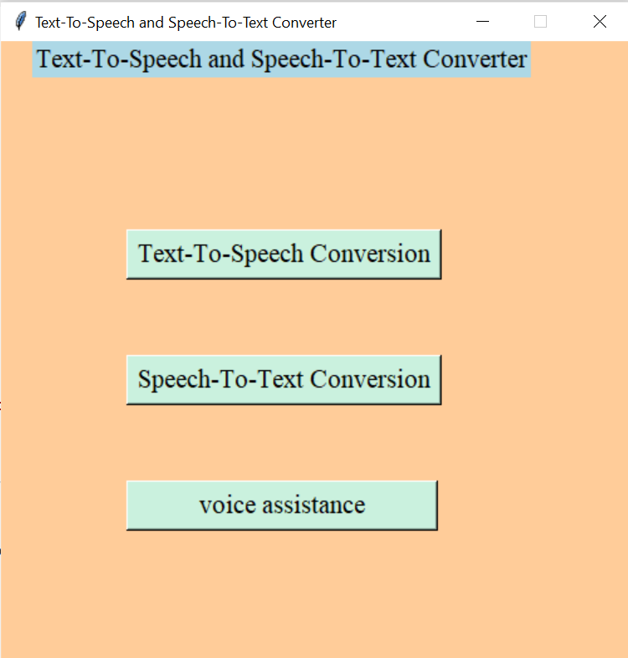
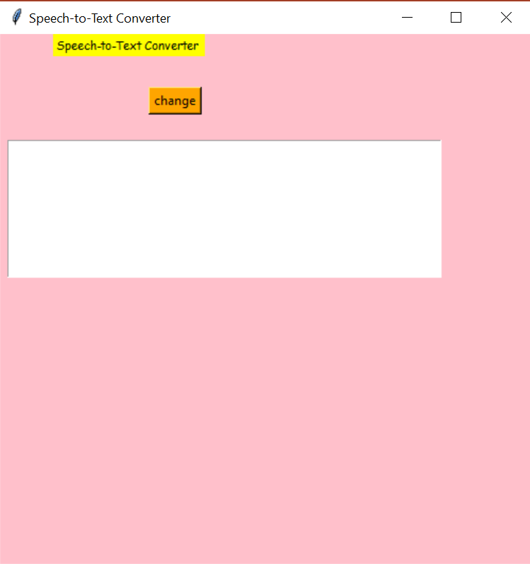
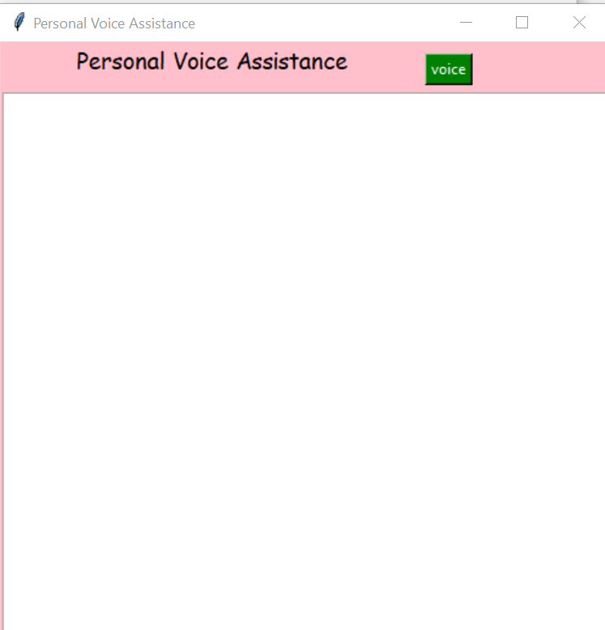
OUTPUT

Slide 9
DEMO VIDEO

Slide 10
CONCLUTION
Speech-to-text has many benefits that help us improve daily processes. Such as:
Save time
Enhance audio and video content
Text-to-speech is mainly used for visually impaired people in mobile phones as Talkback feature in which the selected text reads out loudly. So that in enhances the usage for them without hassle.
In daily scenarios, Personal Voice Assistant plays a key role by giving a hands-free experience by just recognising voice commands and fulfils the given command.

